Slide 1

Breast Cancer Recognition (Advanced Data Science Capstone)
By Sumit Bhattacharya

Slide 2

Introduction:
Breast cancer is the most widespread type of cancer in women, and invasive ductal carcinoma (IDC) is the most common form of breast cancer. In order to identify the cancerous cells, it requires great expertise and time. Accurately identifying and categorizing breast cancer subtypes is an important clinical task. Manual methods may be erroneous for classification. Automated methods using Machine Learning can be used to save time and reduce errors (especially type 2 error).

Slide 3
IDC is the most common subtype of all breast cancers. To assign an aggressiveness grade to a whole mount sample, pathologists typically focus on the regions which contain the IDC. As a result, one of the common pre-processing steps for automatic aggressiveness grading is to delineate the exact regions of IDC inside of a whole mount slide.

Slide 4
Data Set:
The Data set is obtained from Kaggle (a well known site for Data Science Datasets).
It contains over 277,500 mount image samples categorized into 2 different classes :
0 -> Non-cancerous cells ( Non – IDC
or Negative)
1 -> Cancerous cells (IDC detected or Postive)

Slide 5
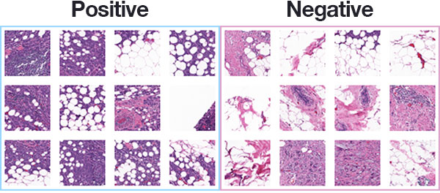
Link to the dataset:- https://www.kaggle.com/paultimothymooney/breast-histopathology-images#IDC_regular_ps50_idx5.zip

Slide 6
Use Case:
An optimum IDC classifier can be used in the Pathology Labs to reduce the time taken for the result of the test to be formulated.
This may also help in reducing error rates.
Such systems installed in the Hospitals can help in fostering affective diagnosis services.
The model can be improved to work with not only the mount images but also other screening images.

Slide 7
Thank You

